Slide 1
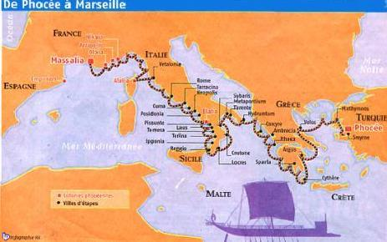
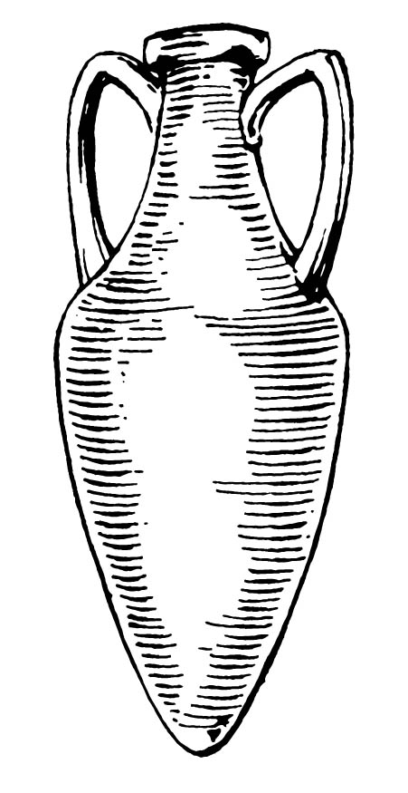
Historical origins of Marseilles
Marseilles : a greek settlement
The Ligurians occupied this part of the coast well before the arrival of the Phocaeans (Greeks from Asia Minor).
Around 620-600 BC, Greek-Phoenician galleys landed at Lacydon Creek, now the Old Port, for the trading post there.
For the following centuries, the Greeks administered Massalia as a republic, renowned as a cultural center and for the wisdom of its laws. The Greek Massalia encompassed the Old Port and the peninsula on the north side, facing the sea.
Marseilles : the oldest city in France

Slide 2
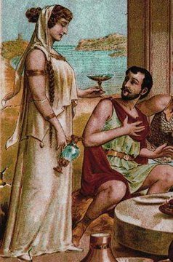
Marseilles : the founding myth
The legend surrounding the origins of the town go back to 600 B.C. : Greek sailors coming from Phocaea (Asia Minor) chose to focus their activity in the Lacydon creek - the present location of the Vieux Port.
The day they arrived, the leader of the Greeks, Protis made a visit to the Ligure tribe, which had settled there.
It just so happened that on that very day, Gyptis, daughter of King Naan was to be married. Gyptis chose Protis as her husband above a number of other suitors - he had also fallen head over heels for her –
and thus, Massalia was founded.
Gyptis and Protis

Slide 3
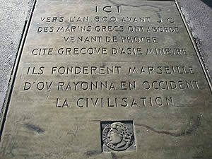
Historical origins of Marseilles
Quai des Belges, the Old Port

Slide 4
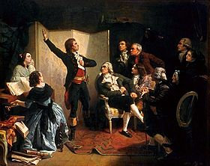
Historical origins of Marseilles
Marseilles played an active role during the crusades and installed consuls in the Levant. It was devastated in 1423 by the armies of Aragon.
It was incorporated into the kingdom of France en 1481.
In 1660 Louis XIV ordered the extension of the city towards the south. Enlarged, and with its Galley Arsenal modernised, the city experienced the most tragic episode of its history, when an epidemic of the plague killed half its population in 1720 (45,000 people).
It recovered its vitality and rose to fame in 1792, when 600 volunteers marched to Paris singing "The Battle Hymn for the Army of the Rhine" composed by Rouget de l’Isle, to rally the forces of the Revolution. This song was to become "La Marseillaise", France's national anthem.
Rouget de Lisle singing « La Marseillaise» for the 1st time in 1792 (Painter : Isidore Pils 1849)

Slide 5
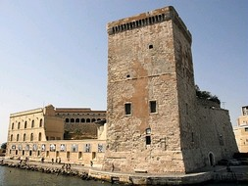
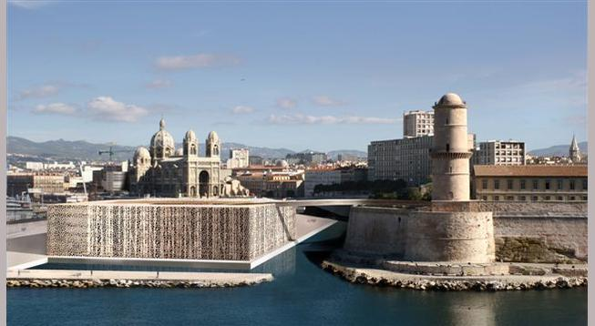
Historical origins of Marseilles
The Fort Saint-Jean
The Fort Saint-Jean site has been occupied since Antiquity but it wasn’t until the 13th century that the Knights of Saint-John (later the Knights of Malta) established themselves here and named the area after them.
The fort maintained a strong military role for over three centuries. Serving as a German ammunition depot during the war, it was severely damaged by an accidental explosion in 1944. It was made a historical monument in 1964 and placed under the surveillance of the French Ministry of Culture. The fort included in MuCEM in 2013.
Le Mucem (architect Rudy Ricciotti) Le Fort Saint-Jean

Slide 6
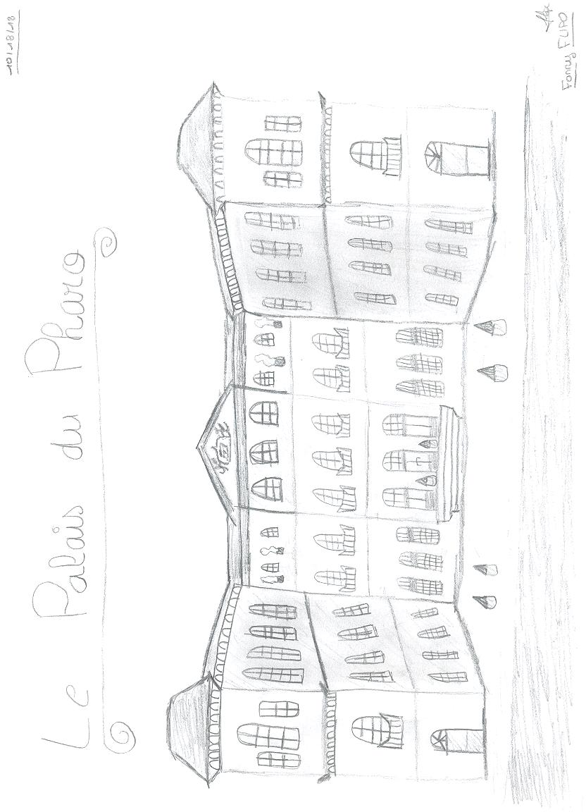
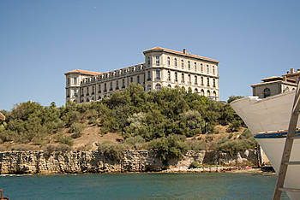
Historical origins of Marseilles
Palais du Pharo
The decision to build an imperial residence in Marseille was made by Louis-Napoléon who, during his trip in 1852. Napoleon III’s architect took on the project and the City decided to donate the chosen land, the Réserve and the Pharo. The Emperor never stayed here. After Napoleon III’s death, Empress Eugénie, the sole heir of the Pharo, gave it to the city. The inside of the Pharo Palace was then refurbished for its reincarnation as a school of medicine in 1904.

Slide 7
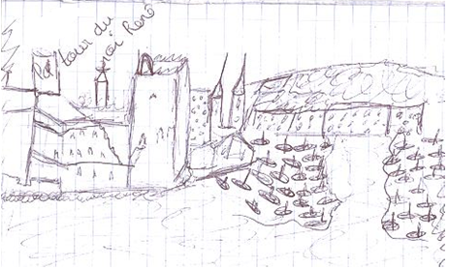
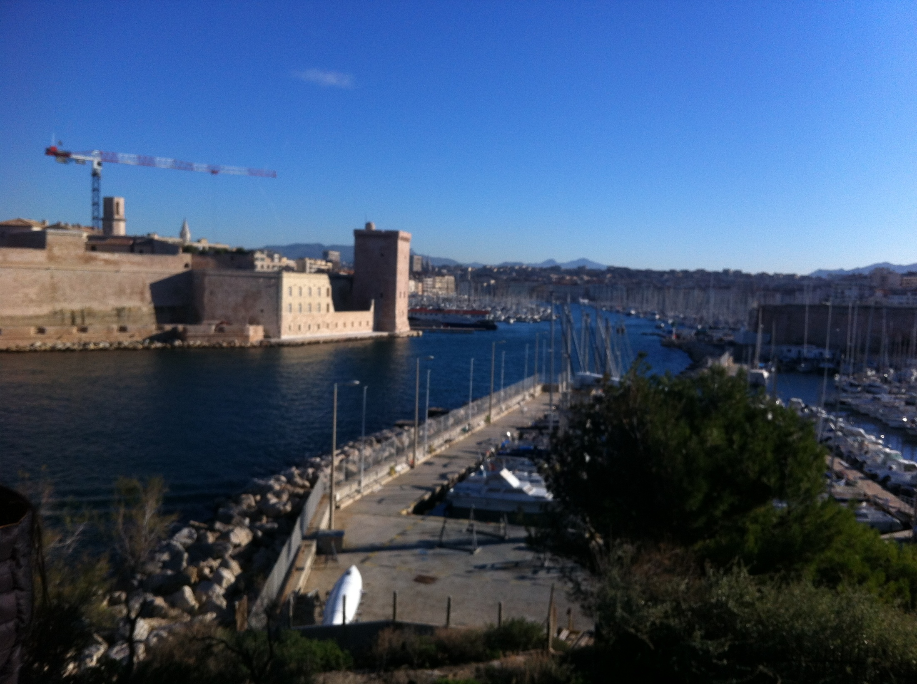
Historical origins of Marseilles
Pupil’s drawing of the Fort Saint-Jean
The old Port..Photo realized from the Palais du Pharo

Slide 8
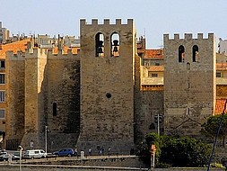
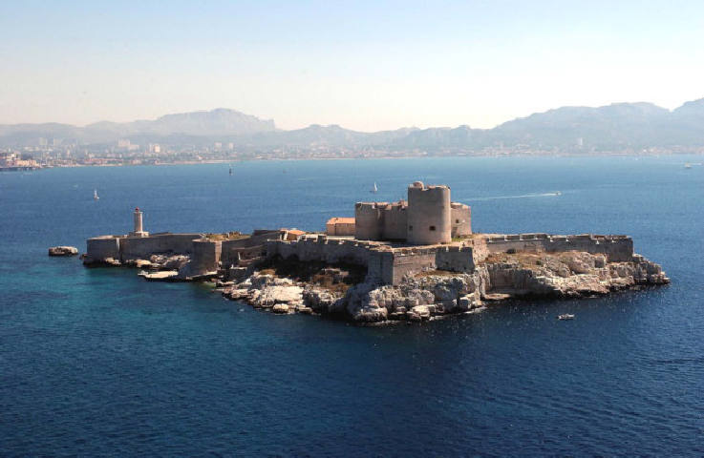
Marseilles Heritage
The Château d'If, the fortress built by Francis I off the coast of Marseilles and whose history is intimately linked to Edmond Dantes, the famous Count of Monte Cristo imagined by Alexandre Dumas.
The cradle of Christianity in Europe symbolized by the Saint-Victor Abbey

Slide 9
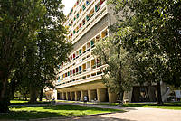
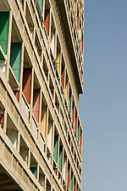
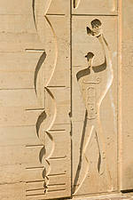
Marseilles Heritage
“The cité radieuse”
the work of Swiss architect Charles-Edouard Jeanneret, better known as
Le Corbusier. The impressive building measures 165m in length, 24m in width and 56m in height and was built between 1947 and 1951. The site is reminiscent of an urban plot in the middle of a park.
The great architect’s signature graphic style brings his visual effects together with a layout which was incredible at the time.
An experiment for a new “habitat system”, the Cité Radieuse has 337 apartments of 23 different types which were comfortable and modern homes for the period.

Slide 10

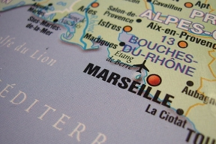
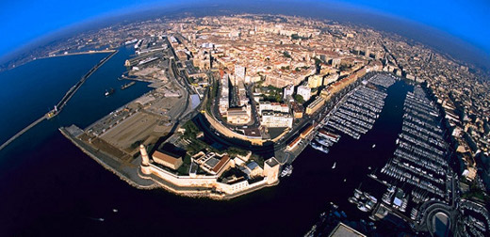
Marseille’s I.D.
­­* St­atus : Capital of the Bouches-du-Rhône department and the Provence-Alpes-Côte d'Azur region.
* Area of the city : 241 km2 of which 100 km2 of natural area
* Population : Second largest city in France with approximately 860 363 inhabitants
Marseilles is one of Europe’s largest and most important ports, and is burgeoning with myriad expansion projects including a redevelopment of its docklands.
It’s Just three hours from Paris by TGV.­ ­ ­­
­­­ ­

Slide 11
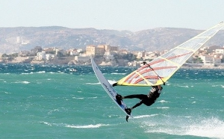
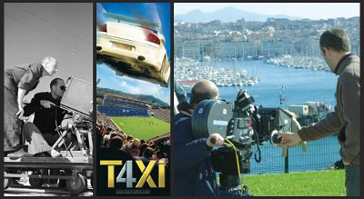
Marseille’s I.D.
Marseille, the city of wate­r sports
With 14 ports spread over 57 kilometres of coastline, Marseille is the largest yachting center in France, and the second largest in Europe. From the exploration of the majestic coves, soon to be under the protection of the national park, the islands of Friuli, and the bay.
Marseille, a city of commerce
Marseille is a market town with a catchment area of ​​nearly 1.7 million people, 15,000 shops, and 4 million tourists including 820,000 cruise passengers.
Marseille, a city of Cinema
It is the most filmed city in France after Paris. Its warm light, blue sea, its rich and varied heritage, and the simplicity of its inhabitants have long attracted filmmakers and inspired scenarists. Established on July 1, 2009, the Belle de Mai multi-media center (films studios)

Slide 12
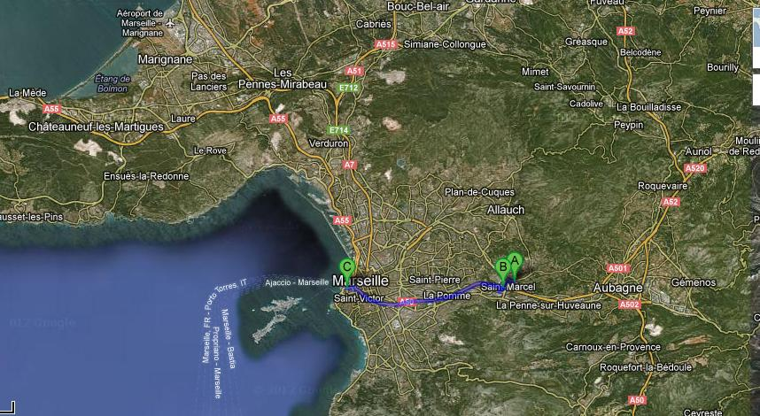
Situation of the School Le Ruissatel in Marseilles
From the old Port to the college

Slide 13
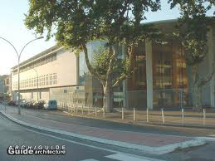
«Welcome to Le Ruissatel »
**the school opens from 7.45 am
to 18 pm
Our school community includes a population of 782 students (children from 11 years old to 15)
and 55 teachers.
Le Ruissatel offers extra-curricular activities to students that include sports, theater and singing lessons.
Our school « Le Ruissatel »

Slide 14
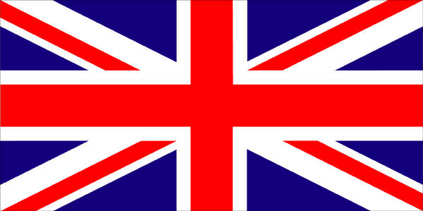
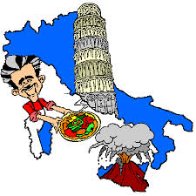

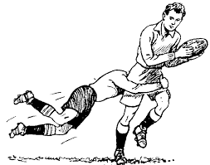
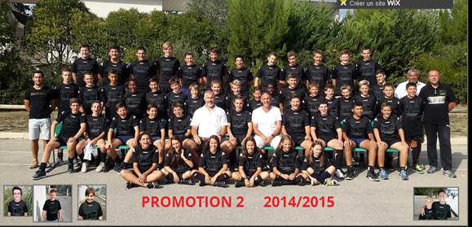
«Welcome to Le Ruissatel »
** 4 age-groups : from 11 years old to 15
*1st age - group : 1/12 years old
pupils began to study english
*3 rd age-group (13 years old ): pupils began to study a second language (Italian, spanish)
*When they finish school at 15, pupils take an exam : « le brevet des collèges »
*The rugby class : a specialized section

Slide 15
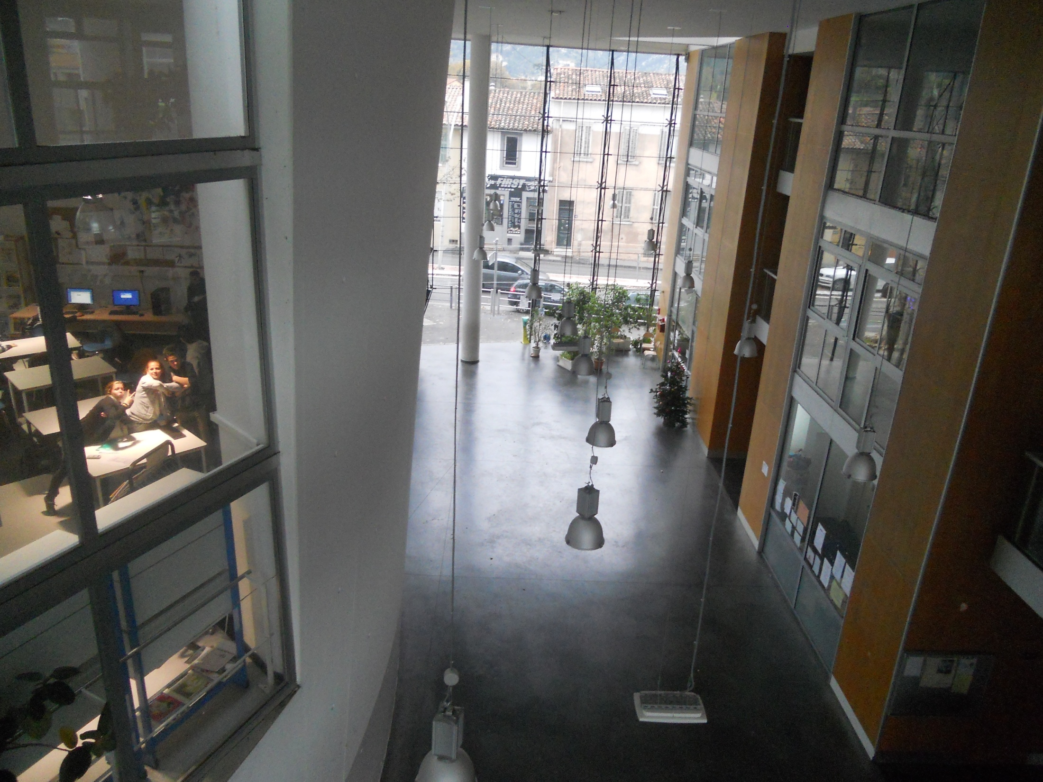
«Welcome to Le Ruissatel »
The entrance hall

Slide 16
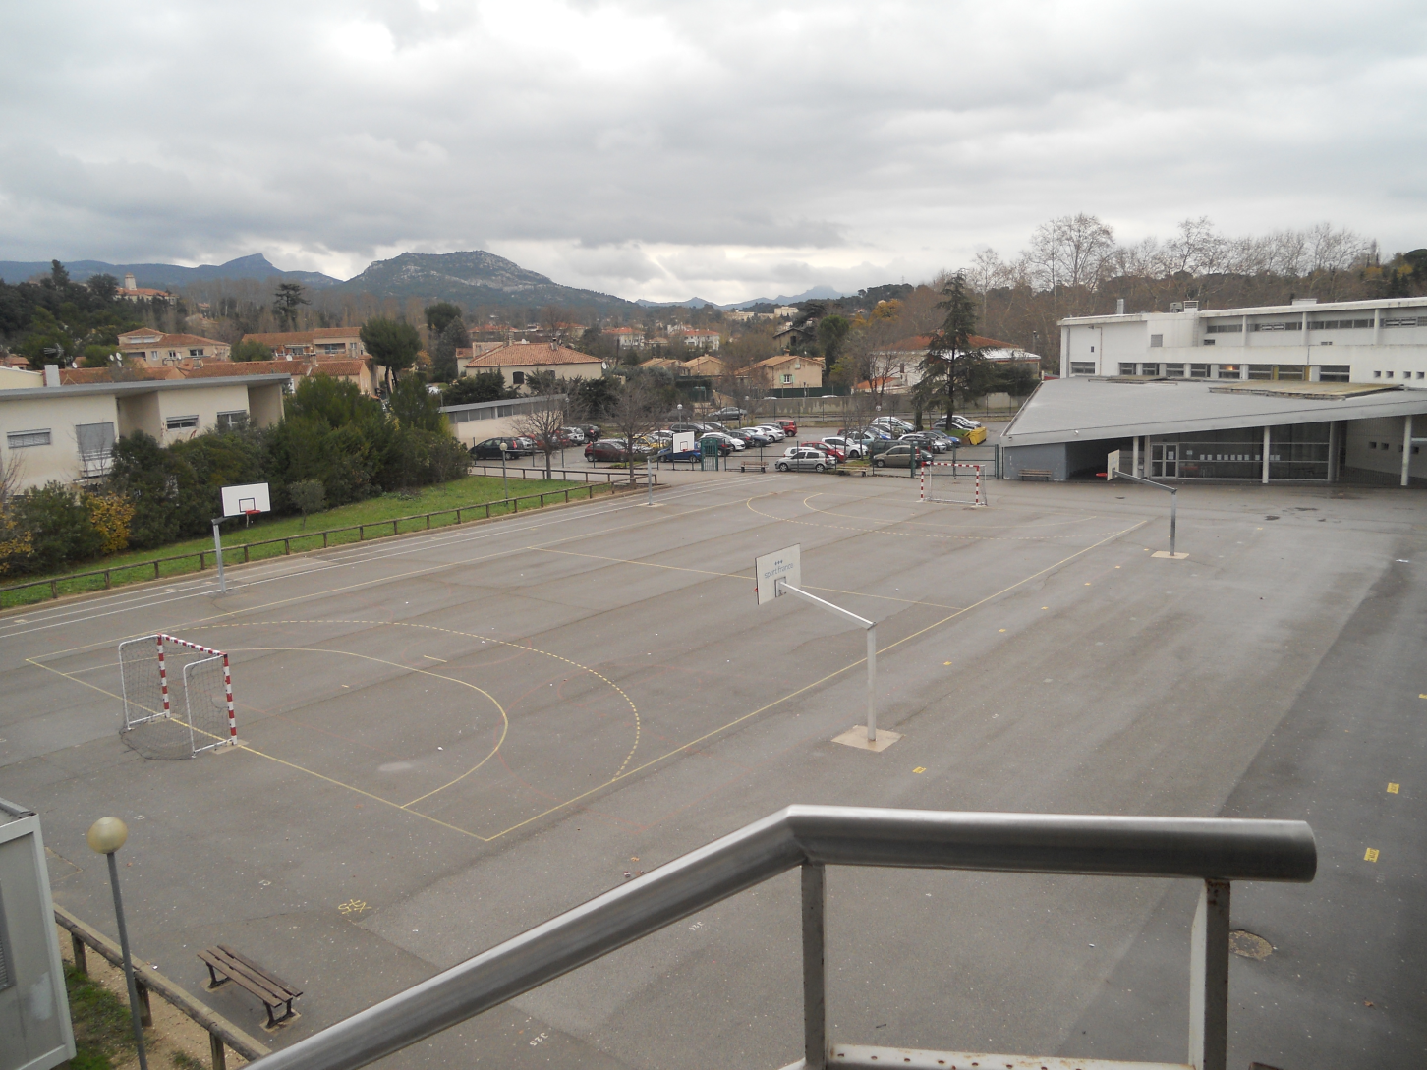
«Welcome to Le Ruissatel »
The school yard

Slide 17
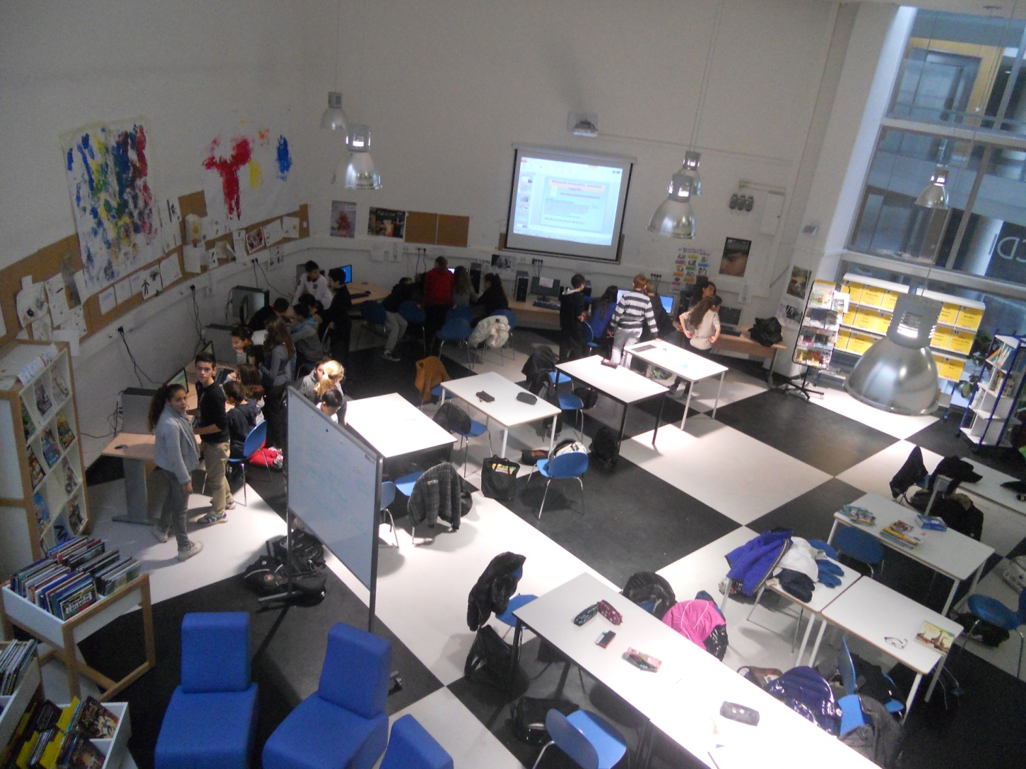
«Welcome to Le Ruissatel »
The multimedia library

Slide 18
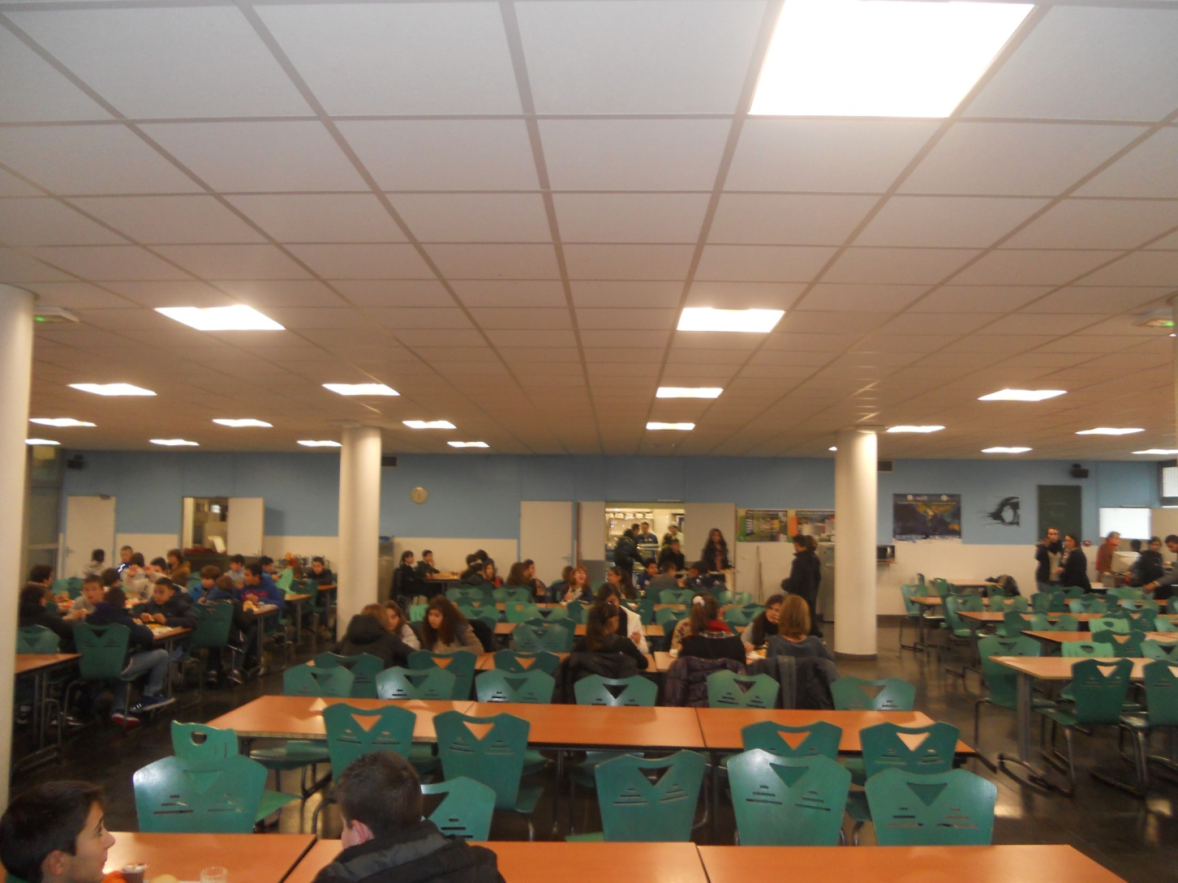
«Welcome to Le Ruissatel »
The dining hall

